Slide 1
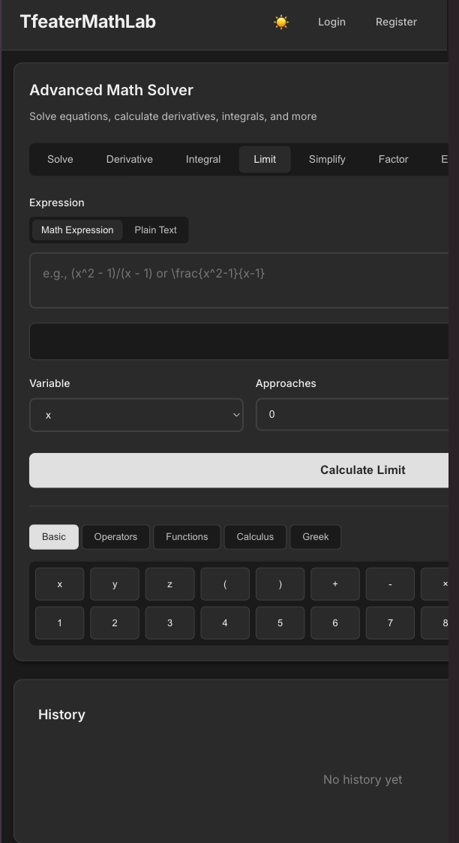


TfeaterMathLab
An Advanced Web-Based Mathematics Solver
Student: Artemiy Plisko
Course: CS-2432
Technologies: Django, Python, SymPy

Slide 2



Project Motivation: Addressing Common Challenges
Struggling with Understanding
Difficulty in Visualisation
Access to Proprietary Tools
Many students find it challenging to grasp complex mathematical concepts and the intricate steps involved in solving problems, leading to frustration and learning gaps.
Visualising abstract mathematical ideas, especially functions and their behaviour, is often a significant hurdle for effective learning and comprehension.
Reliance on expensive or closed-source platforms like Symbolab limits access for many, creating barriers to equitable educational resources.
This project aims to democratize access to high-quality mathematical learning tools.

Slide 3
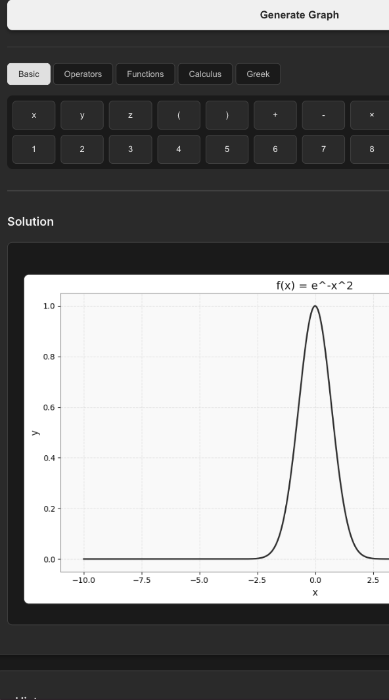
TfeaterMathLab: An Overview
TfeaterMathLab is a comprehensive, full-stack web application designed to enhance the functionality of services like Symbolab and other online math tools
Key Objective
To provide a free, transparent, and education-focused math solver that prioritises learning over simply presenting final answers.
It combines robust symbolic computation with an intuitive web interface, making advanced mathematics accessible to all.

Slide 4
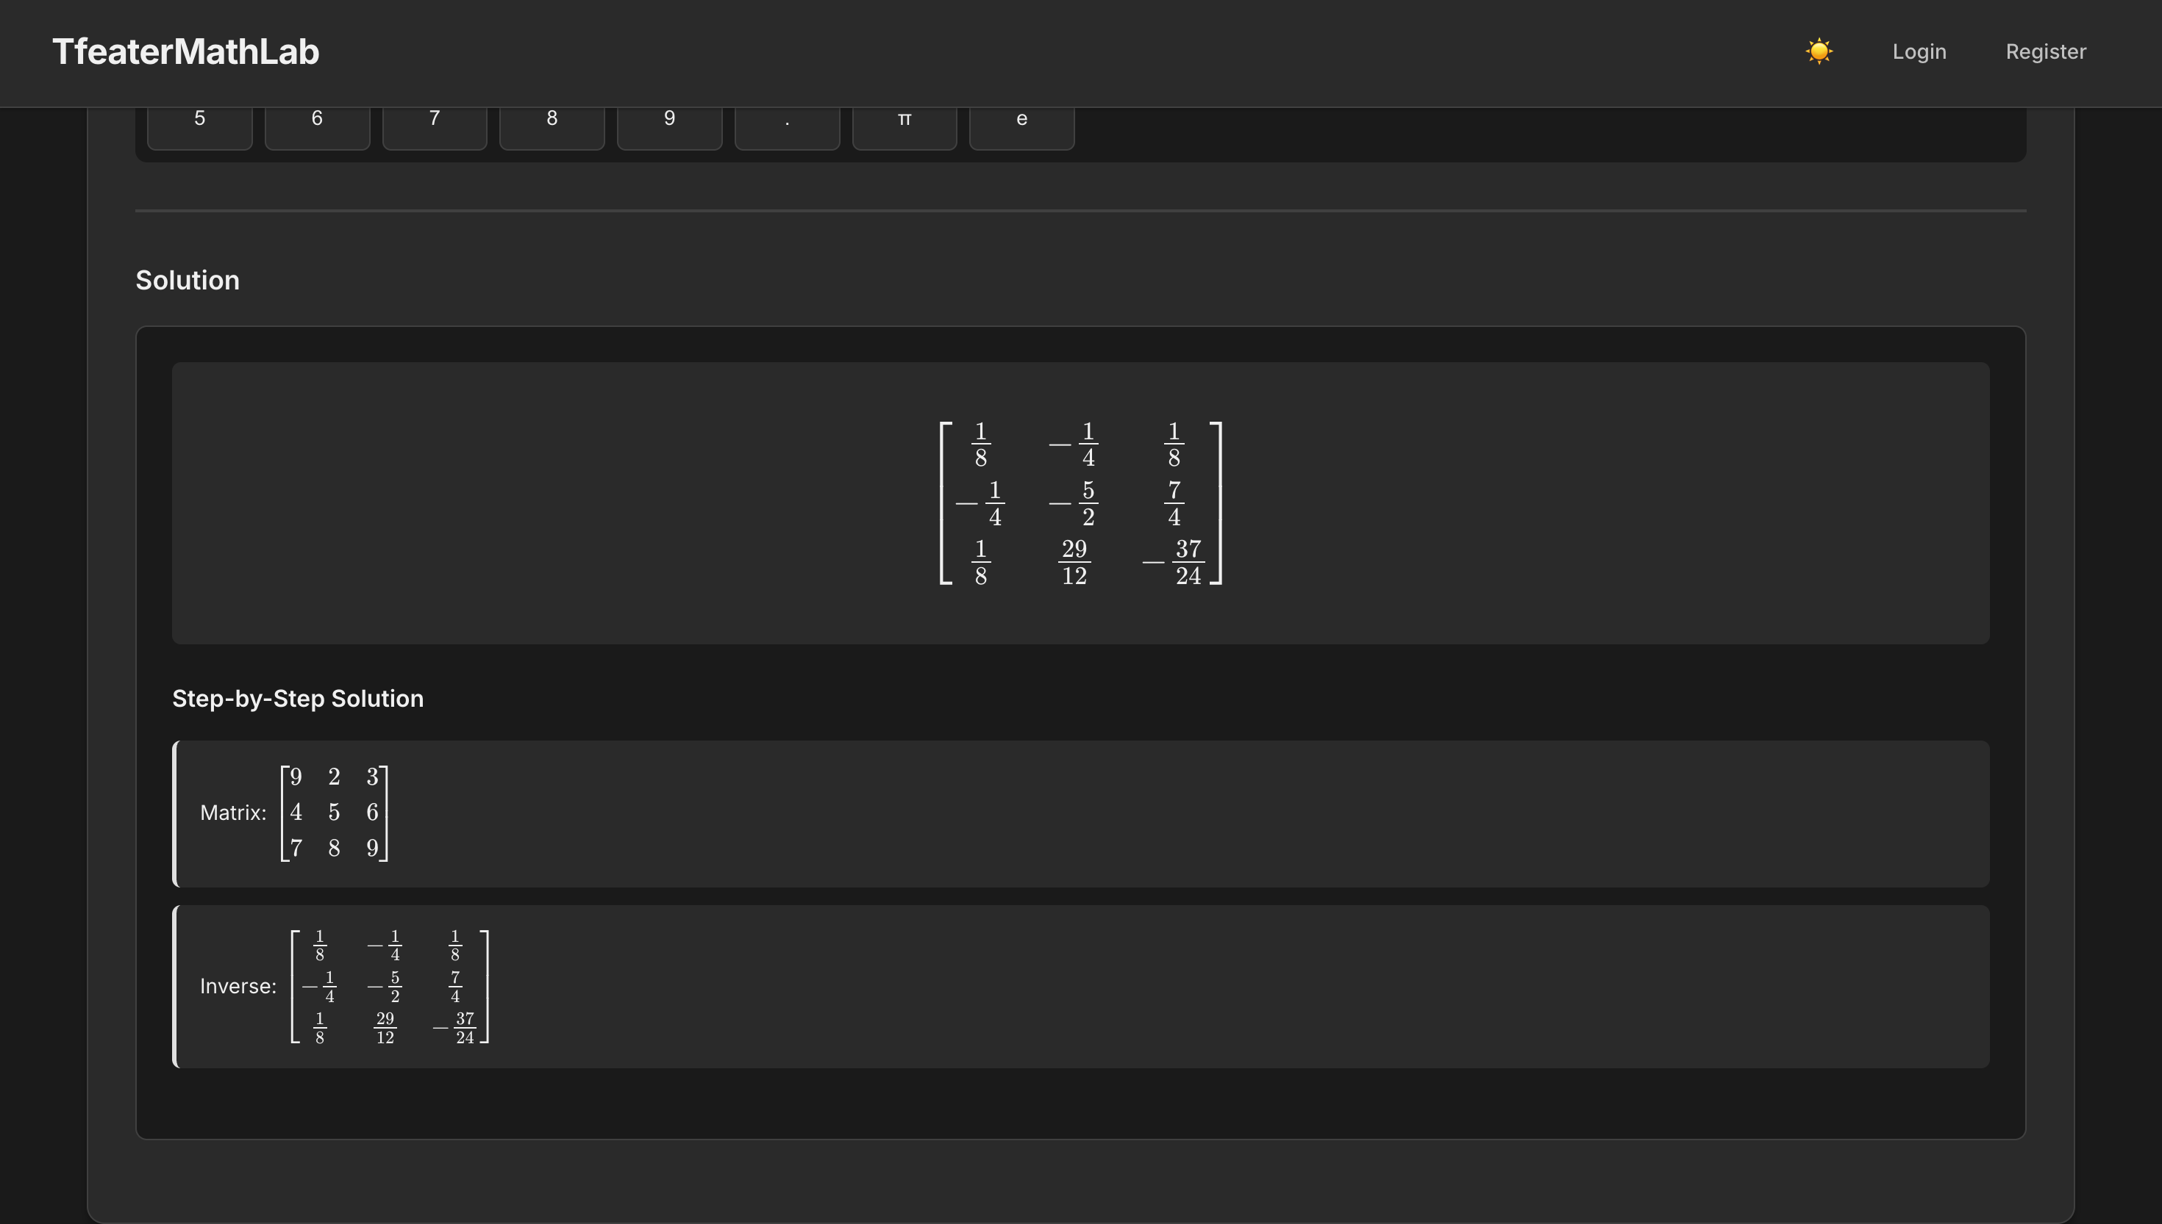
Core Features: Unleashing Mathematical Potential
Mathematical Capabilities
Algebraic Equation Solving: Tackling complex equations with ease.
Calculus Operations: Derivatives, integrals, and limits, with detailed explanations.
Algebraic Simplification: Factoring, expanding, and simplifying expressions.
Matrix Operations: Determinants, inverses, transposes, and Row Echelon Form (RREF).
Graph Plotting: Visualising functions in 2D to aid understanding.
Detailed Step-by-Step Solutions
Calculation History
LaTeX Rendering (MathJax)

Slide 5
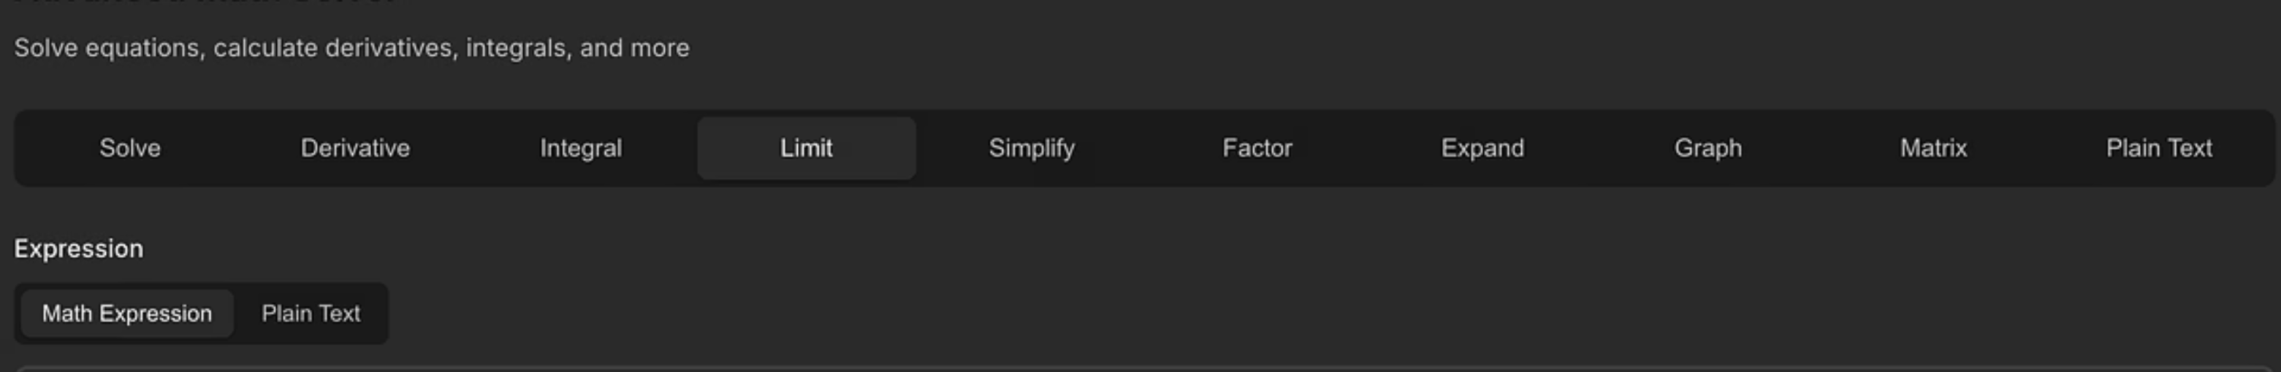



Technology Stack: The Engine Behind Math Solver
Backend
Frontend
Visualisation
Django 4.2: Robust web framework for rapid development.
HTML, CSS, JavaScript: Standard web technologies for interactive interfaces.
Matplotlib: Employed for generating clear and precise 2D graphs.
SQLite3: Lightweight database for development and local storage.
MathJax: For beautiful and accurate LaTeX math rendering.
SymPy: The powerhouse for symbolic mathematics.
UI: A modern, clean, and distraction-free design.
NumPy & Pandas: Essential for numerical processing tasks.

Slide 6
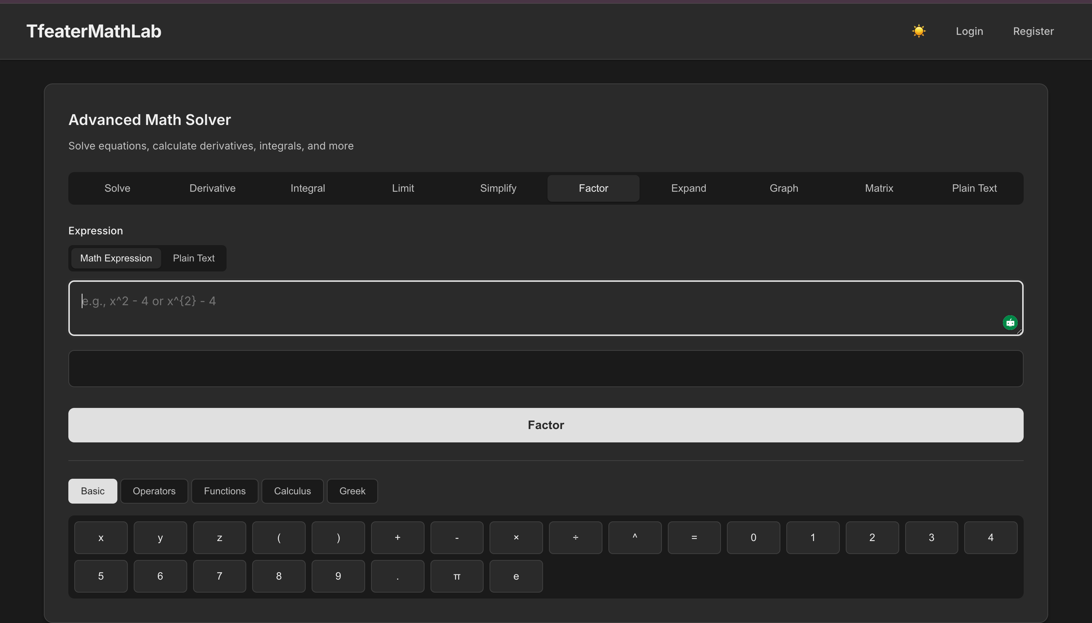

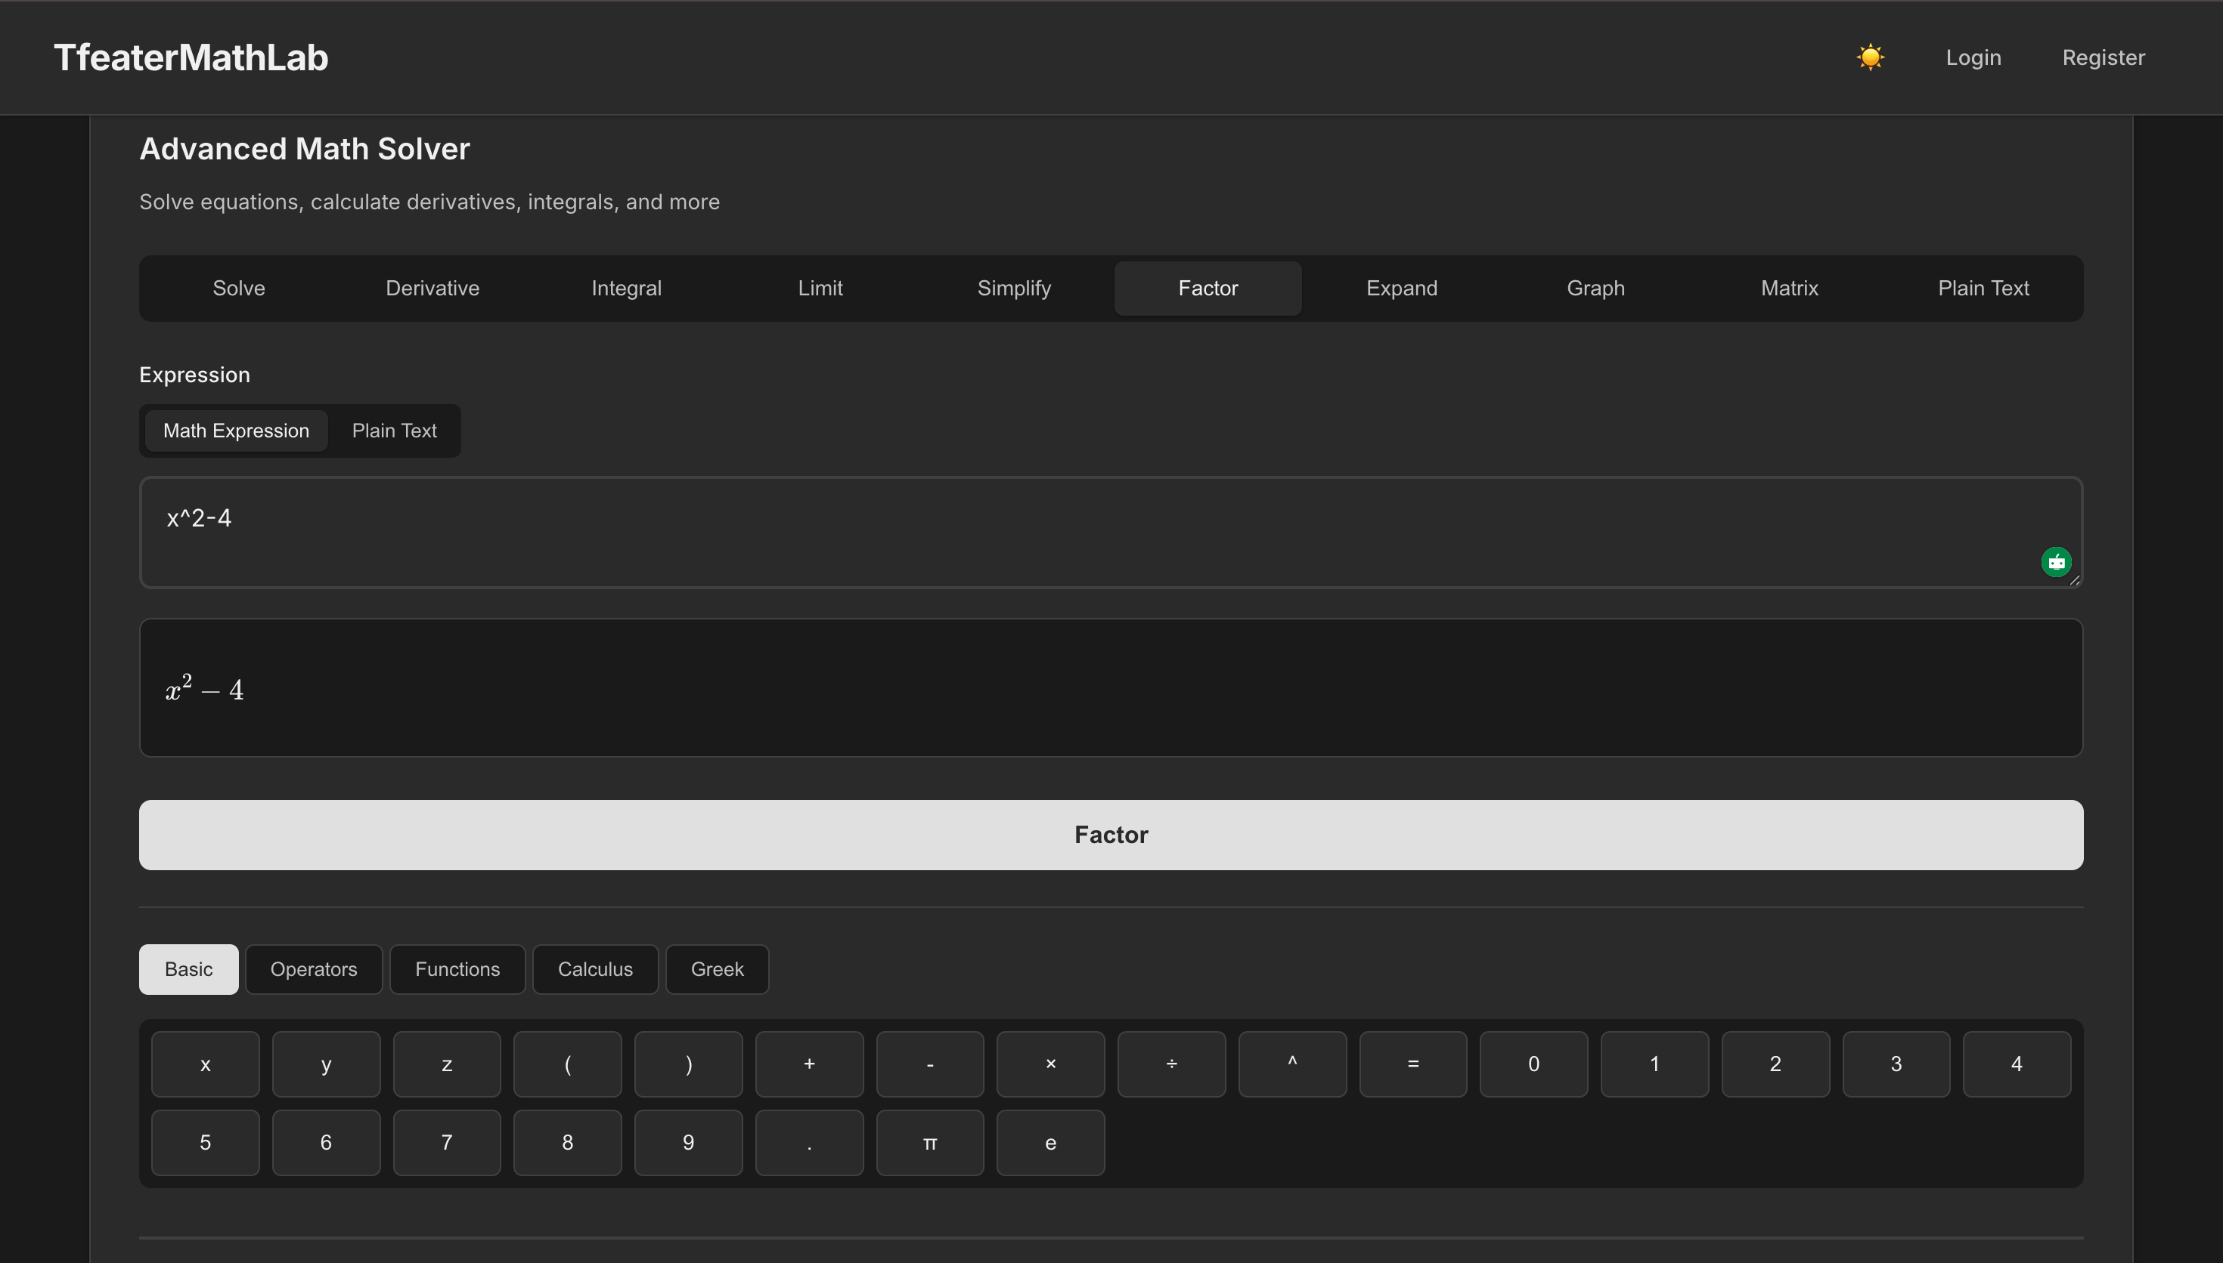
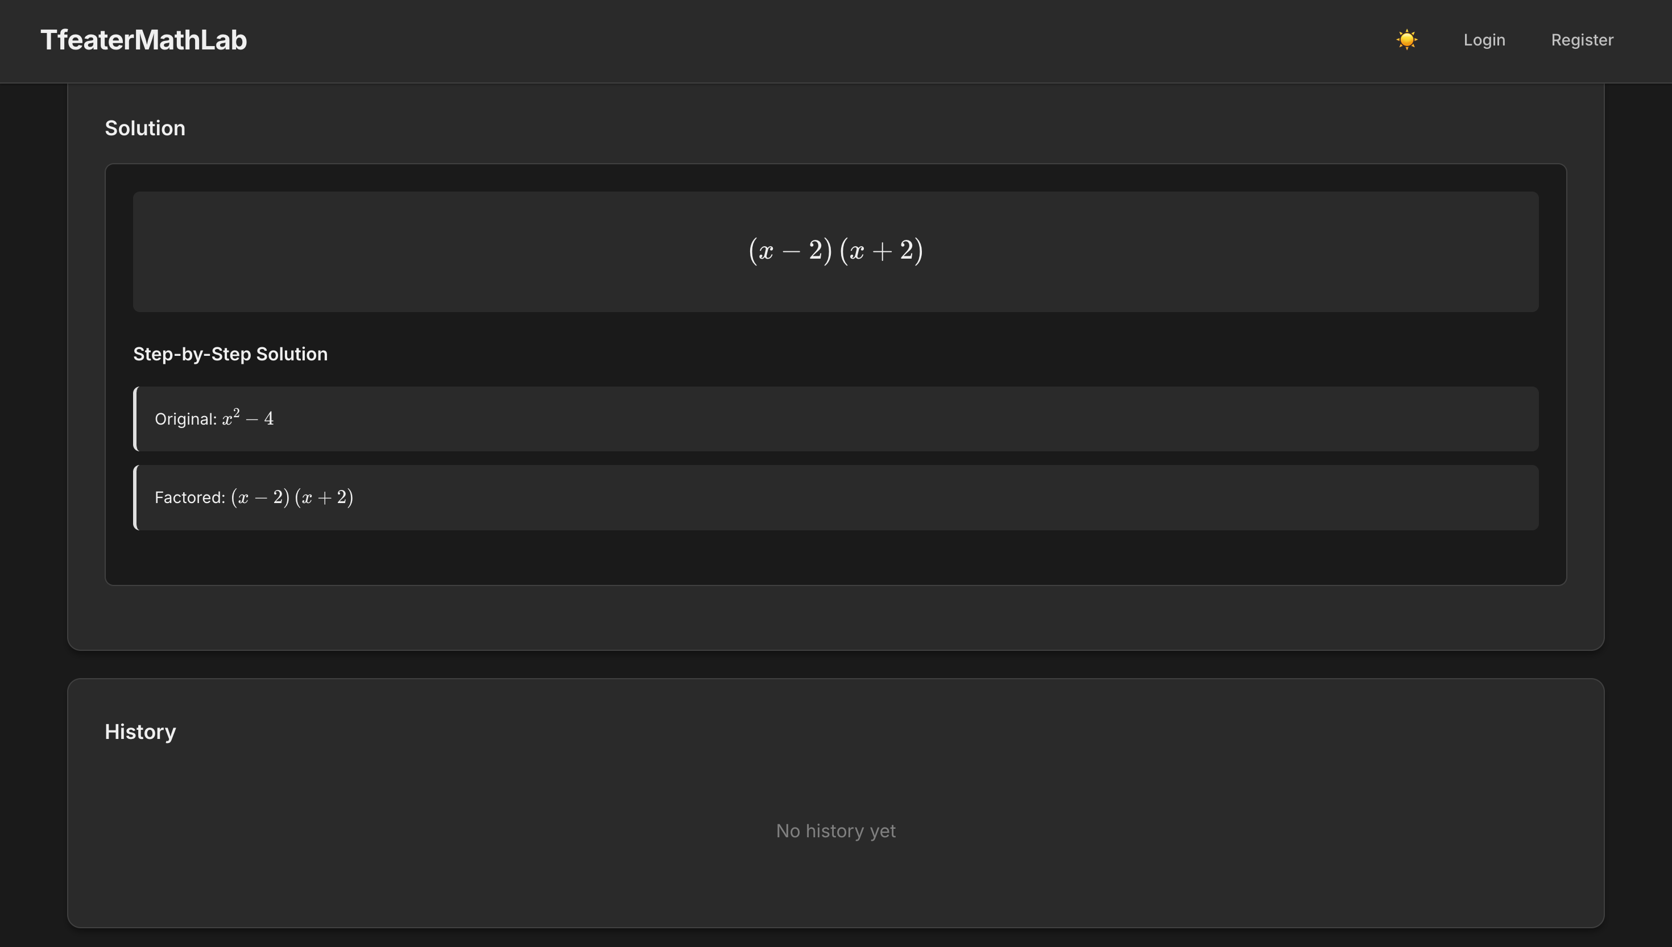
System Architecture: A Structured Approach
User Input
SymPy Compute
LaTeX Render
Parse & Validate
Stepwise Solution
Design Principle: Separation of Concerns
UI: Handles presentation and user interaction.
Logic: Manages application flow and data processing.
Math Engine: Dedicated to performing all mathematical computations.
Data Storage: Responsible for persistent data management.

Slide 7
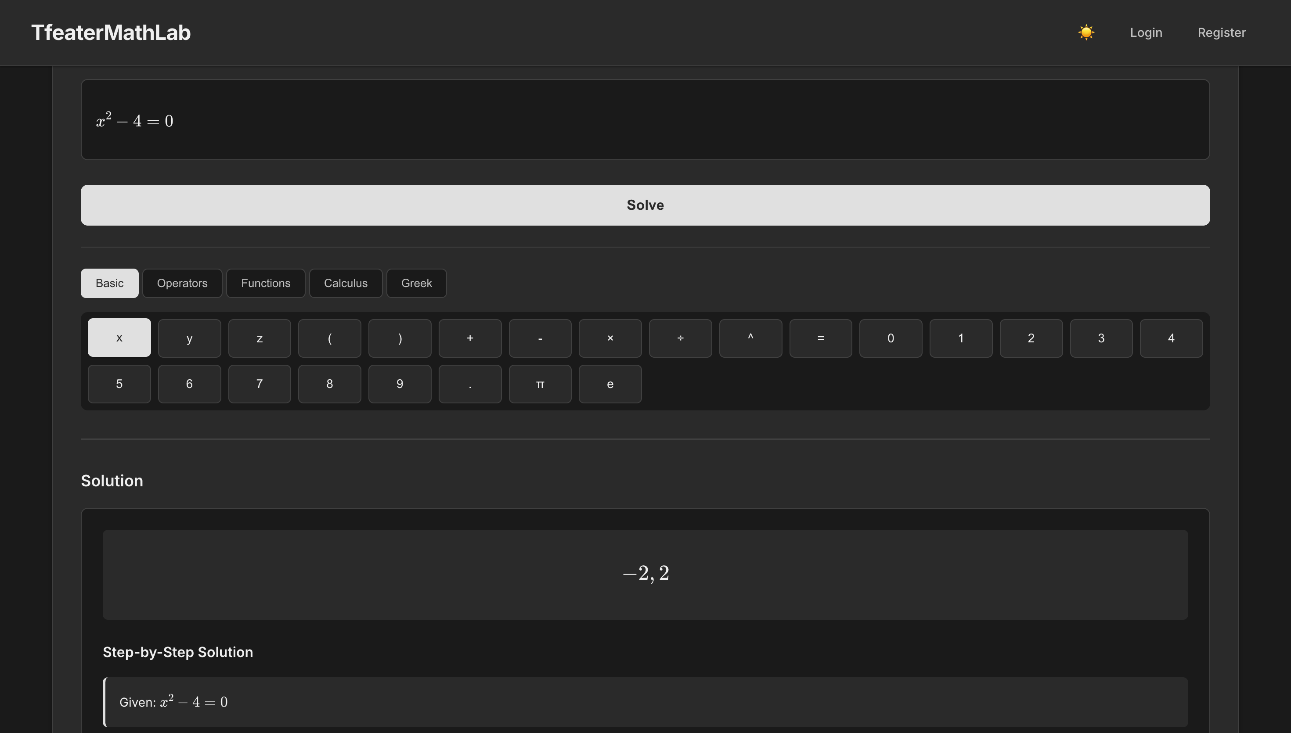
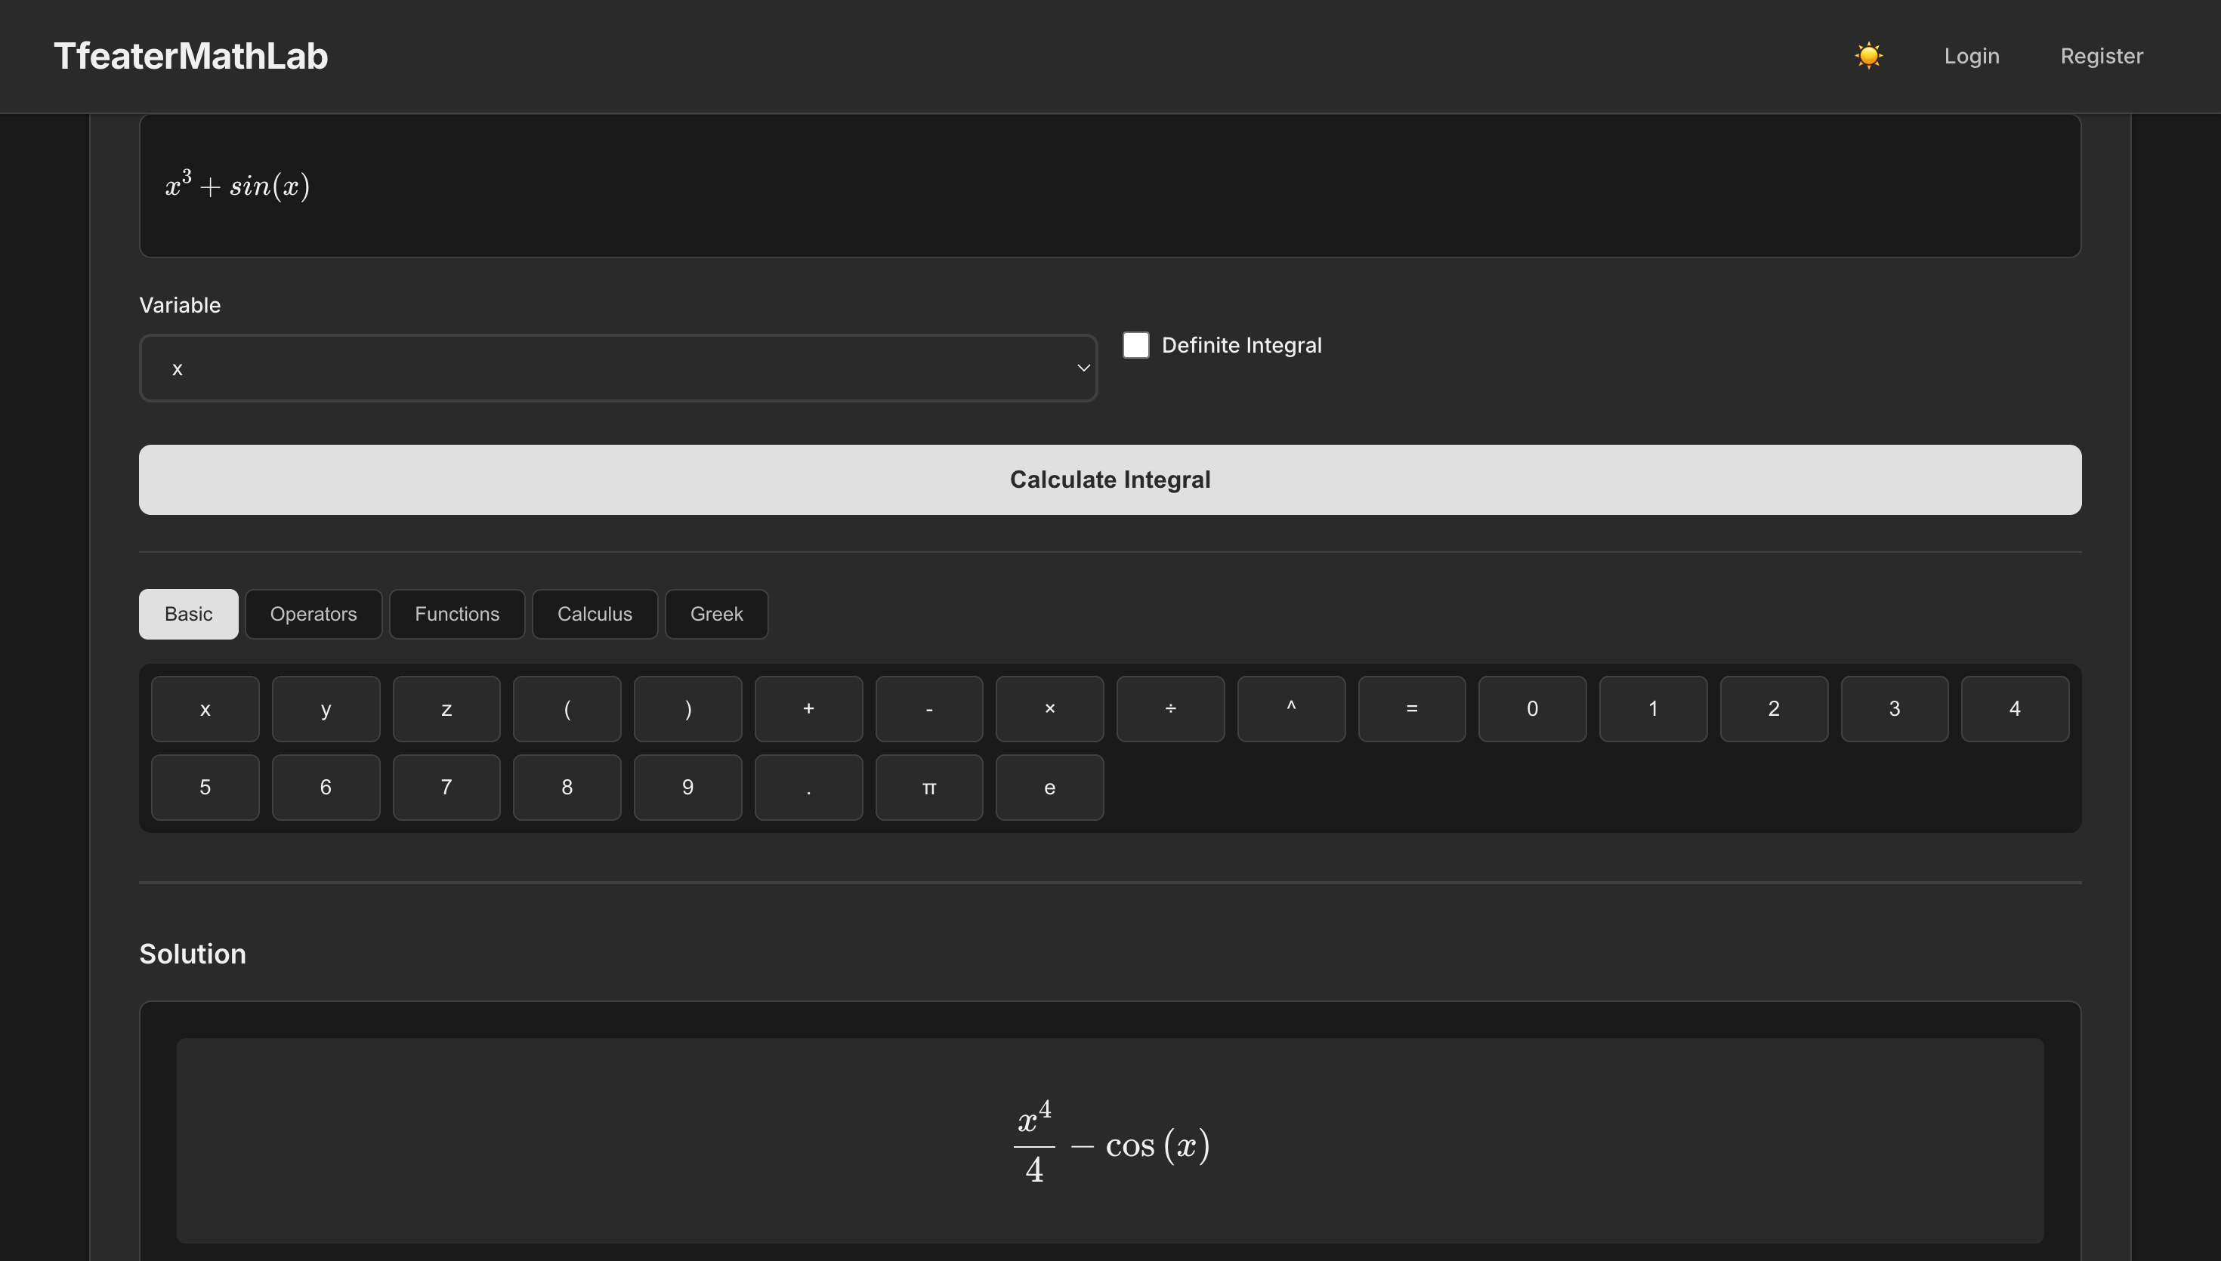
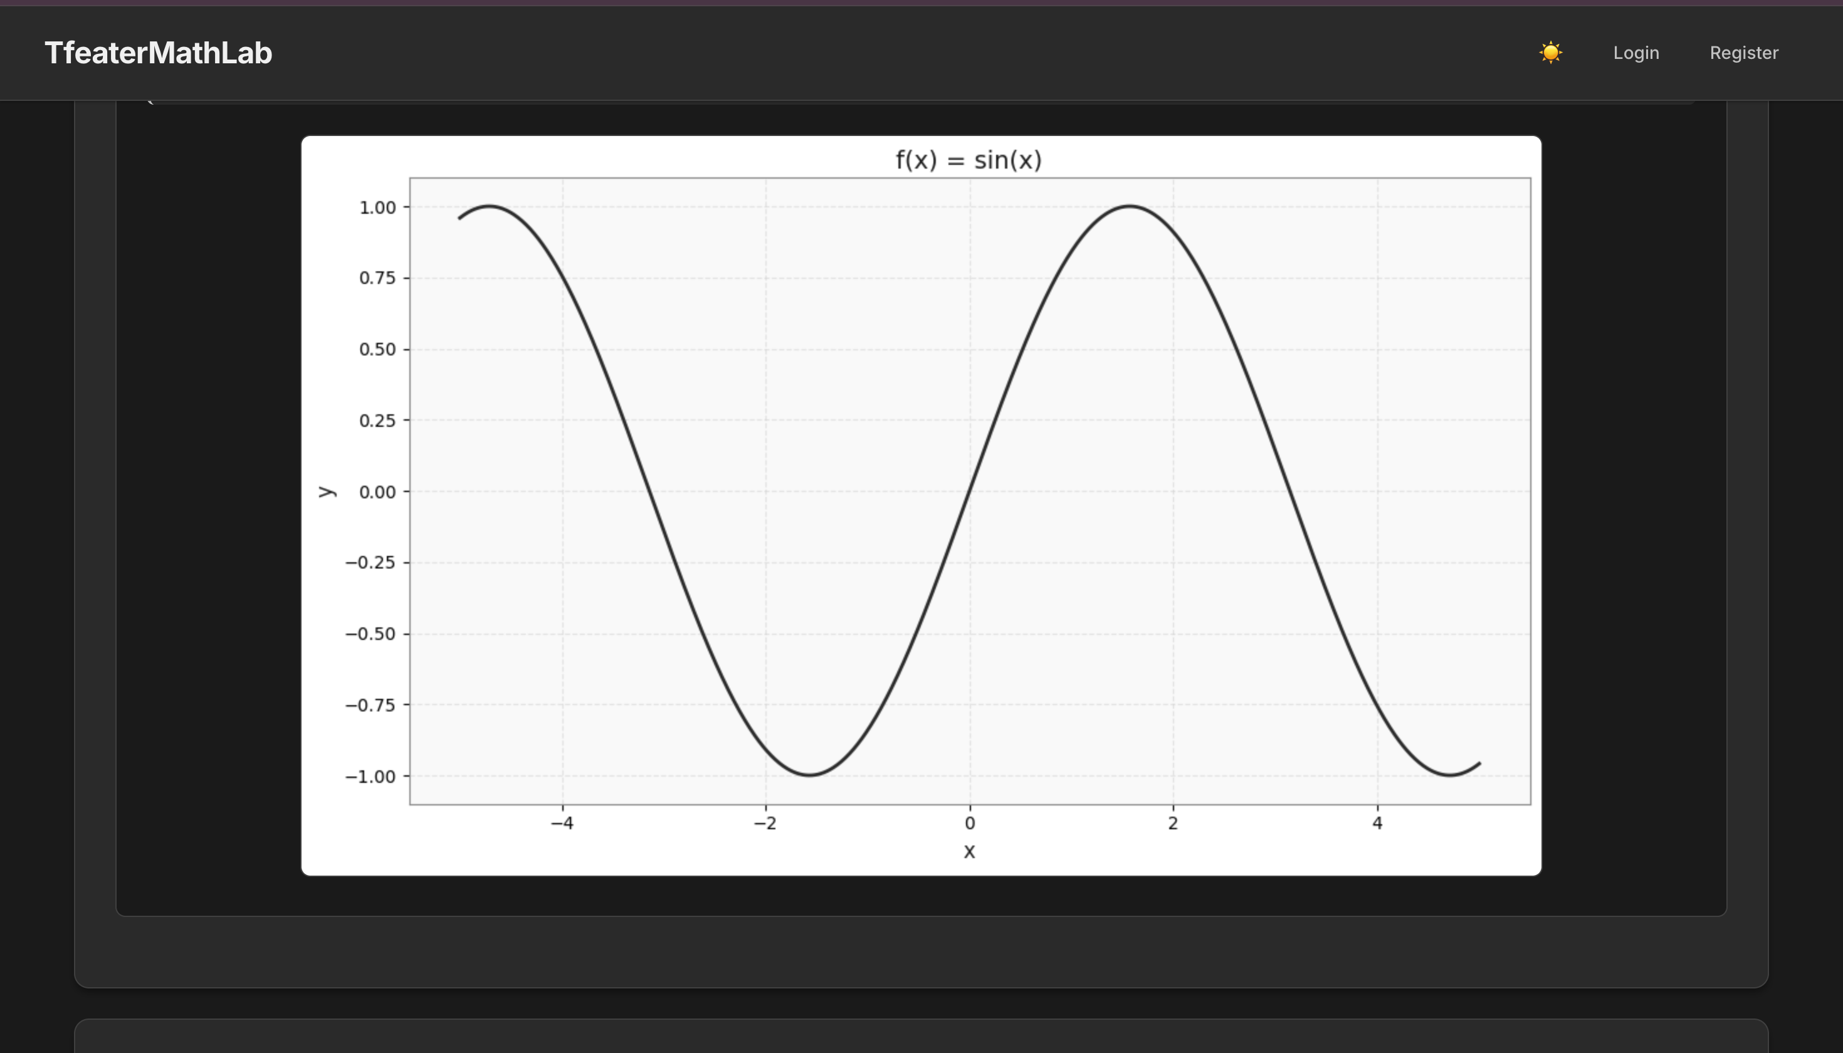

Example Use Cases: Practical Applications
There was an error generating this image
There was an error generating this image
Equation Solving
Advanced Calculus
Function Graphing
Inputting x^2 - 4 = 0 yields a detailed step-by-step solution process, showing the roots: x = ±2.
Solve derivatives like x^3 + sin(x), definite integrals, and evaluate limits with explanations of each step.
Visualise various functions such as x^2, sin(x), and exp(x), with customisable X and Y axis ranges for focused analysis.
These examples highlight the solver's capability to assist in diverse mathematical domains.

Slide 8
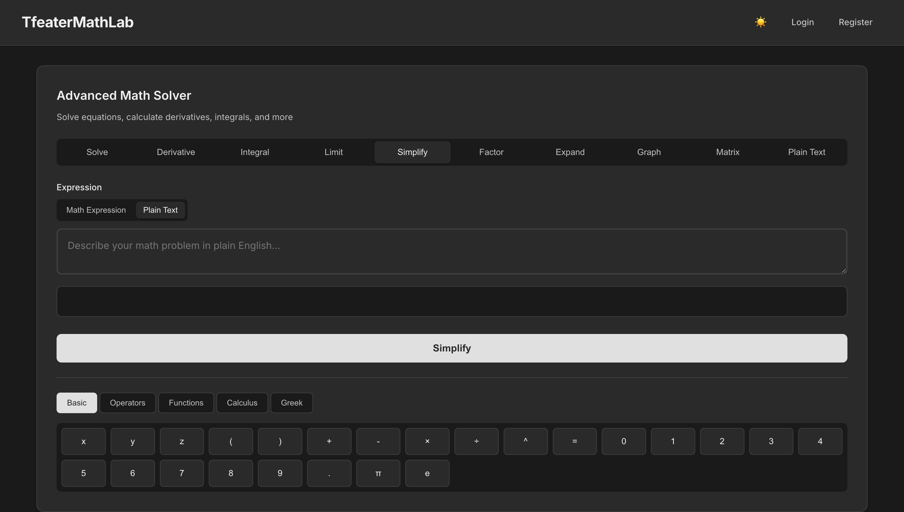
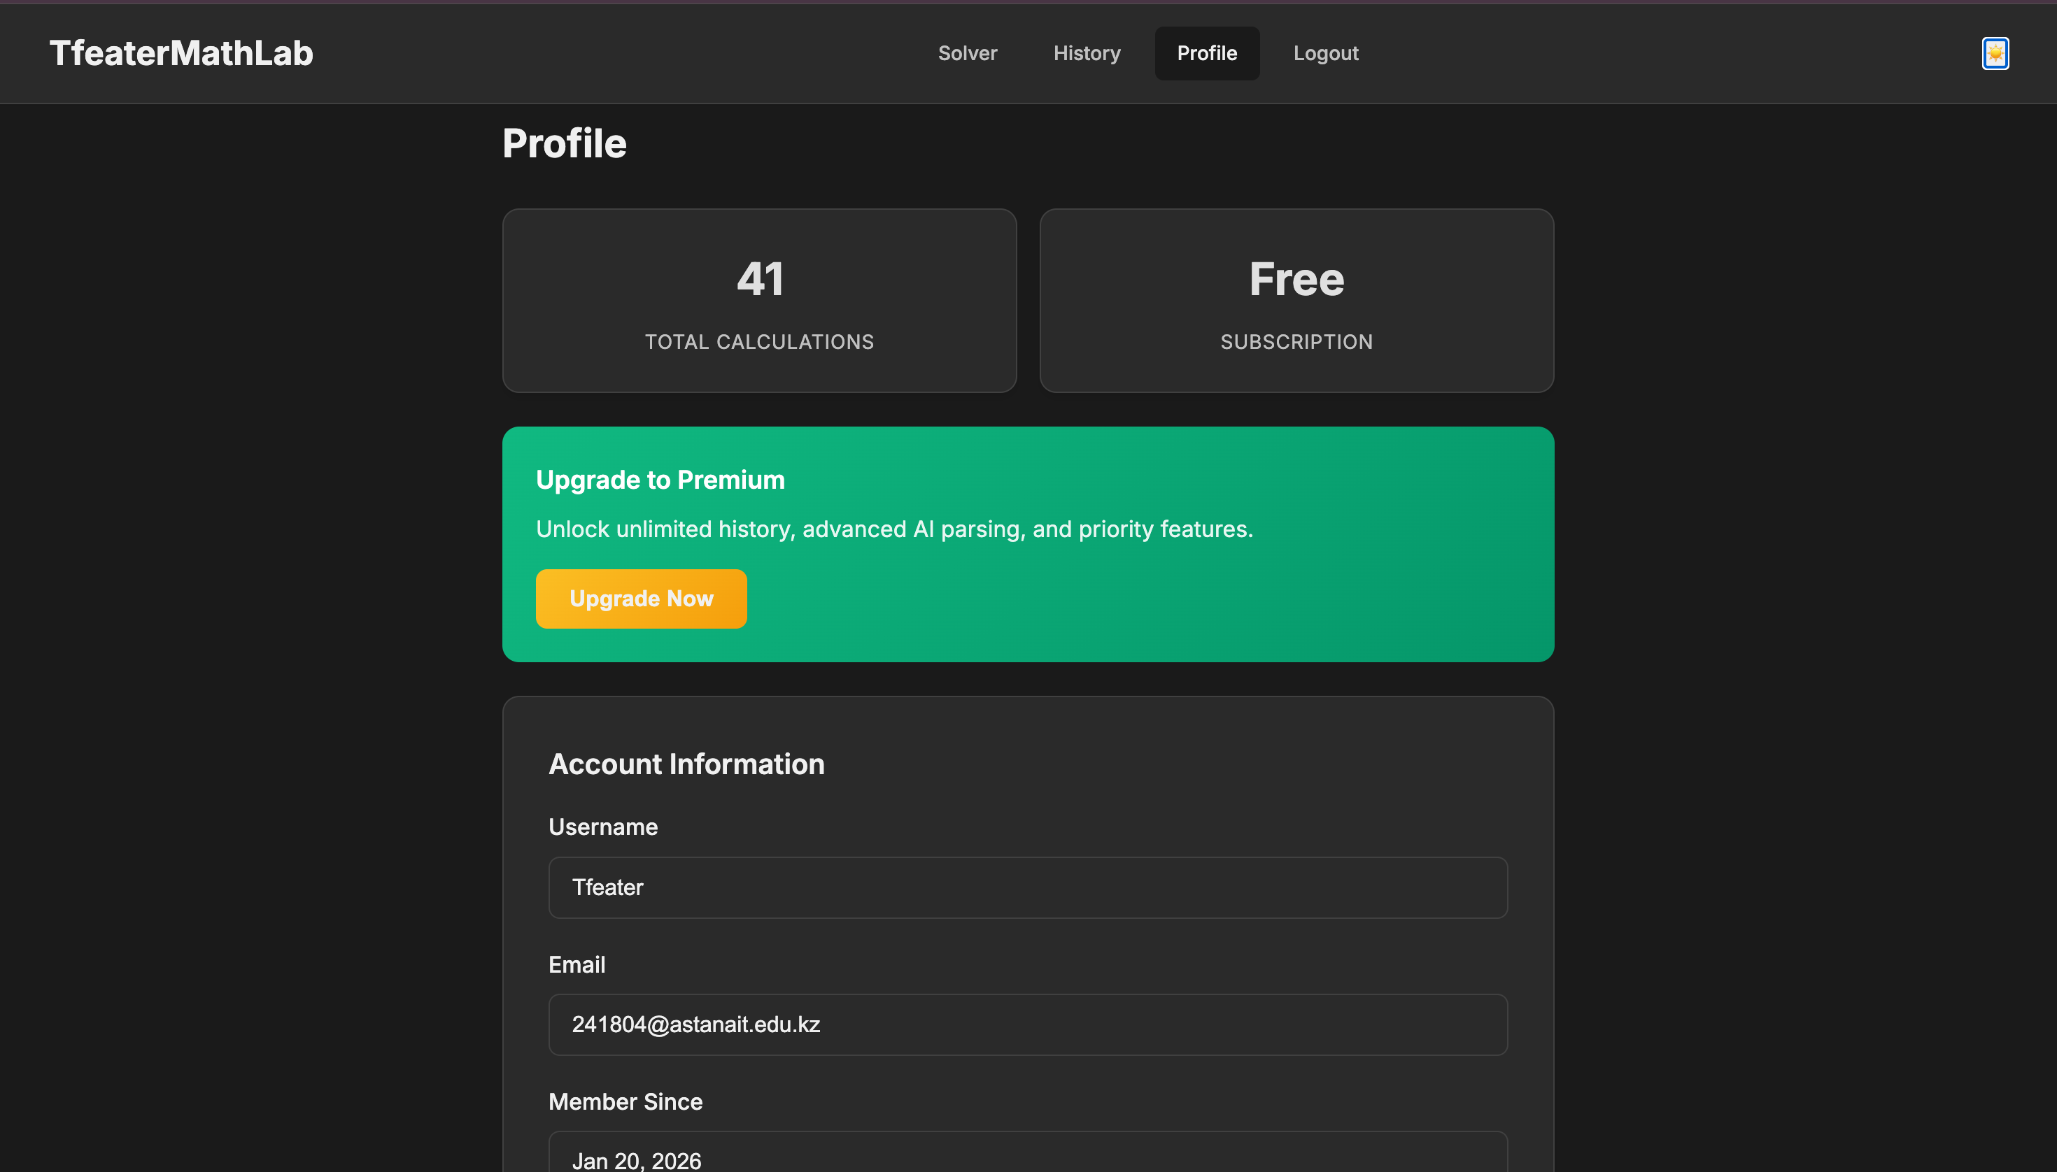
User Interface Design: Clarity and Readability
Design Goals
UX Highlights
Minimalist Grayscale Palette: Reduces visual clutter, focusing attention on content.
Dark Theme Support: Planned for future, enhancing user comfort and accessibility.
No Visual Noise: Ensures a clean and professional look.
Math Preview: Real-time rendering of input for verification before solving.
Focus on Readability: Prioritises clear presentation of mathematical expressions and text.
Every design choice was made to ensure an optimal user experience, free from distractions.

Slide 9
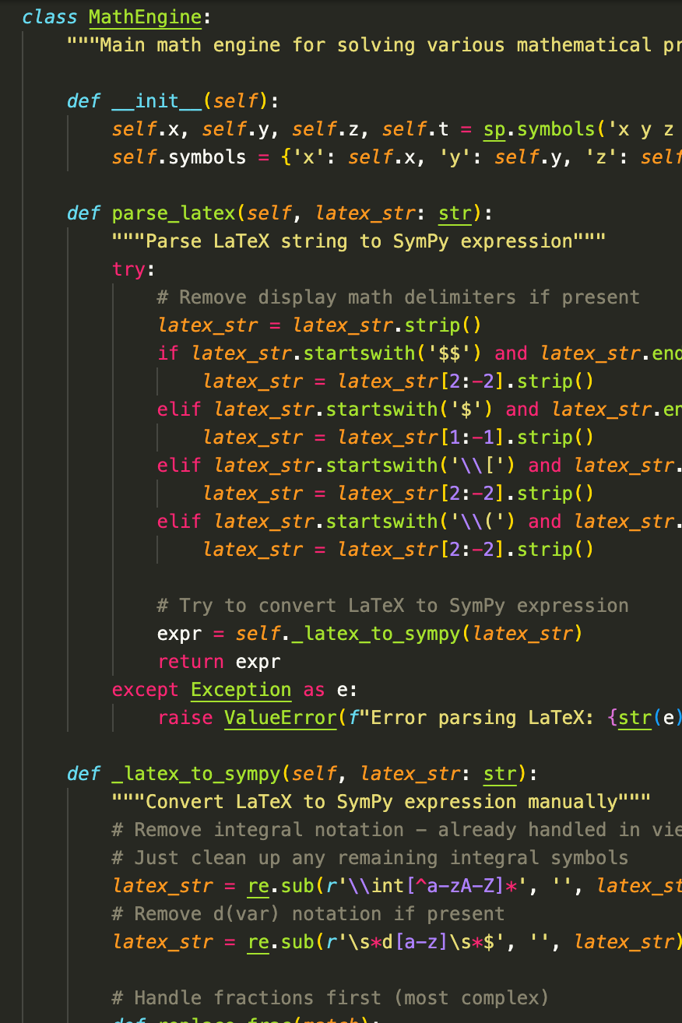

Project Structure: Maintainability and Scalability
math_engine.py
1
Dedicated to handling all symbolic computations, ensuring a clean separation from application logic.
2
graph_generator.py
Manages the plotting logic for visualising mathematical functions.
views.py
3
Responsible for processing user requests and managing the data flow between frontend and backend.
4
Templates
HTML templates are kept separate from the core logic, facilitating easier UI modifications.
Benefits of this Organised Django Layout
Easy Maintenance: Code is modular, simplifying updates and bug fixes
Scalable Structure: Designed to accommodate future feature additions
Future Extensions Ready: Provides a solid foundation for further development

Slide 10





Future Enhancements: Towards a Comprehensive Learning Platform
PDF Export
Allowing users to export solutions for offline review or sharing.
3D Graphing
Expanding visualisation capabilities to three-dimensional functions.
AI-Based NLP
Implementing artificial intelligence for natural language problem understanding, making input more intuitive.
User Accounts & Tracking
Introducing user profiles, progress tracking, and personalised learning paths.
Practice & Quizzes
Integrating interactive problems and quizzes to reinforce learning.
These planned improvements aim to transform Math Solver into a dynamic and interactive
full learning platform, not just a problem solver.

